Slide 1

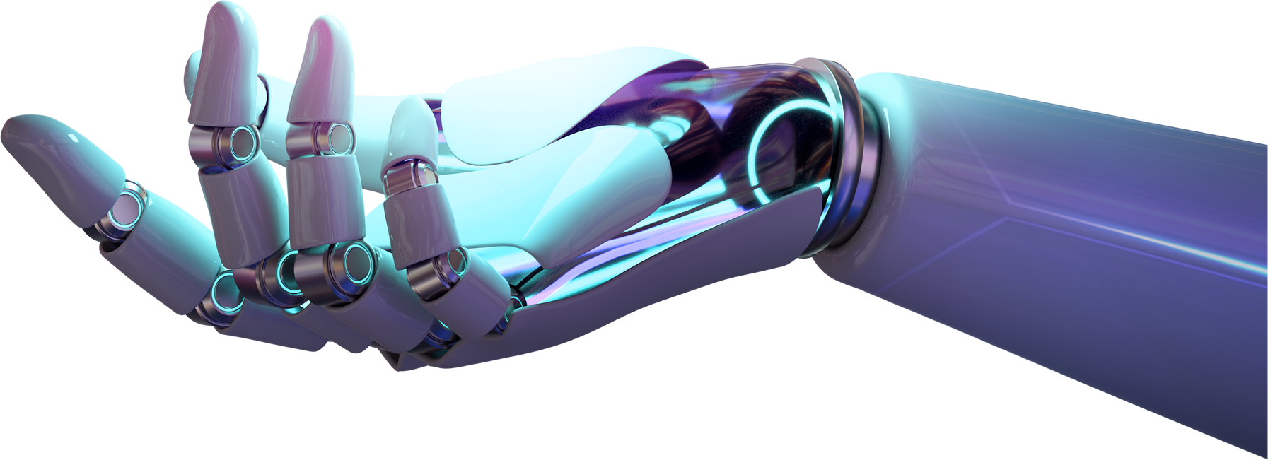
Sensor Glove
FOR SIGN LANGUAGE

Slide 2
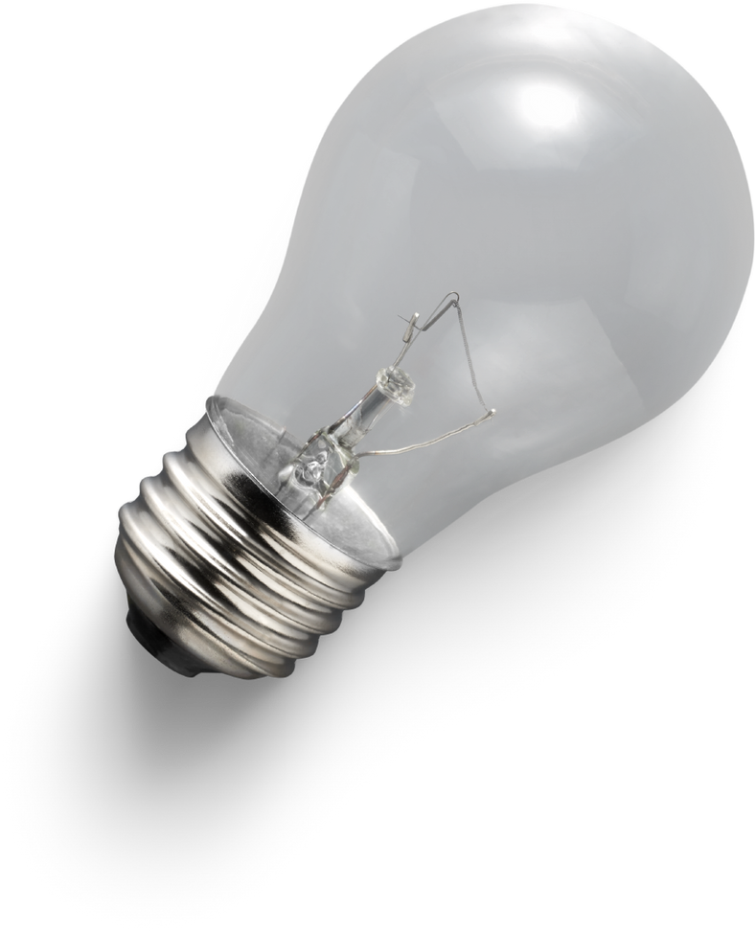
5.
1.
ProjectExplaination
Abstract
6.
2.
Block Diagram
introduction
3.
7.
Programming Code
Literature Survey
4.
Project descrption
8.
Conclusion
Table of contents

Slide 3
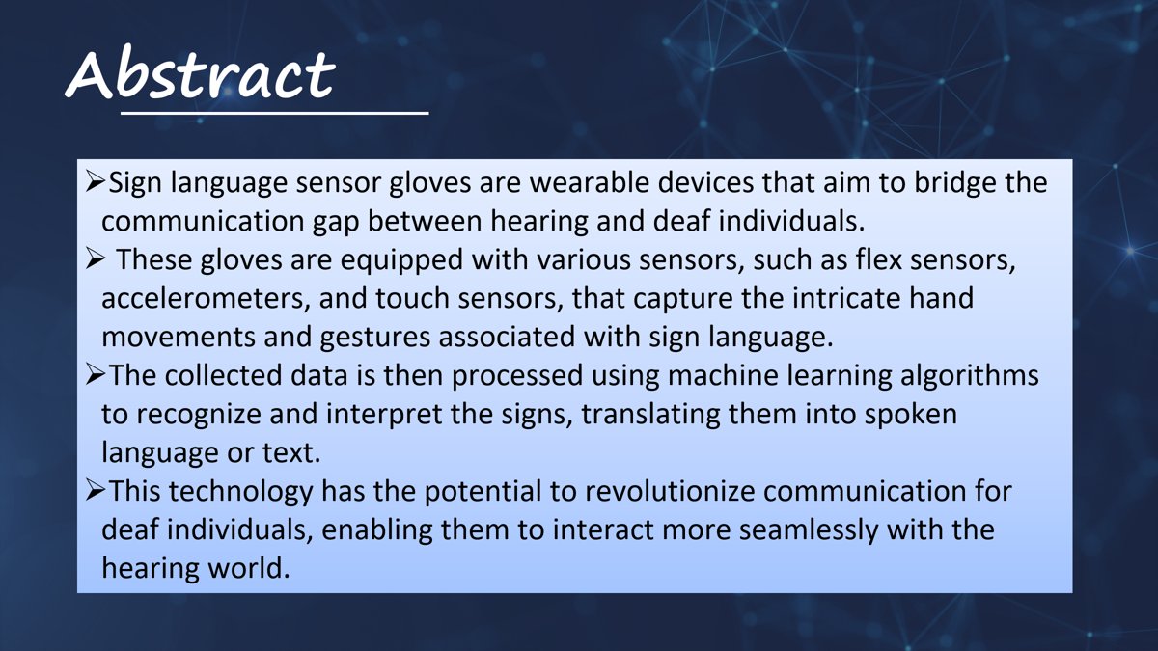

Slide 4





Sensor Glove
Home
About
Contact
Introduction
Individuals with speech or hearing impairments often face significant challenges in communicating with those who do not understand sign language. This can lead to social isolation and difficulties in accessing education, employment, and healthcare.
Many public spaces and services lack the necessary accommodations for individuals with hearing impairments, making it hard for them to navigate and interact with their surroundings.Sign sensor gloves offer a promising solution to these issues by providing a means for effective communication and improving accessibility. They can help bridge the communication gap and promote inclusivity in various settings, such as schools, workplaces, and public services.
Read More
Search Presentation

Slide 5


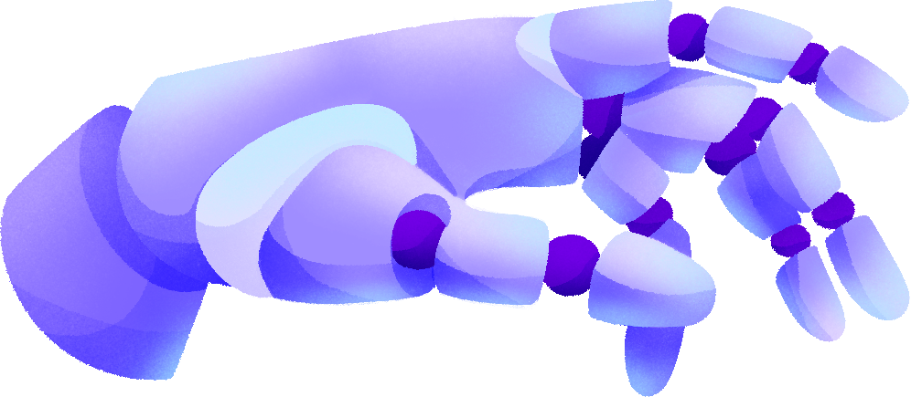
Literature
Survey
1. U.S. Patent No. 5,699,441 - Sagawa et al. (1997)
2. U.S. Patent No. 8,140,339 - Hernandez-Rebollar (2012)
3.Patent: US20020152077A1-M. Orlando Trujillo,Randall Patterson

Slide 6


Title: Sign Language Recognition Glove
U.S. Patent No. 5,699,441 - Sagawa et al. (1997)
Introduction
This patent by Sagawa et al. describes a sensor-equipped glove that recognizes hand gestures associated with sign language. The glove integrates multiple sensors to detect the position, orientation, and flex of each finger. Key sensors include flex sensors embedded along each finger to measure bending angles, and accelerometers to determine hand movement and orientation in space.
Features
Flex Sensors: Measure the bending degree of each finger, capturing the specific finger positions required for sign language.
Accelerometers and Gyroscopes: Measure hand movement and orientation, helping to distinguish between signs that involve similar hand shapes but different motions.
Recognition Process: The apparatus recognizes sign language by matching the input hand gestures with the stored template patterns. This allows for continuous and real-time recognition of sign language1.
Applications: The system can be used in various applications, such as communication aids for individuals with hearing impairments, educational tools, and interactive systems.
Challenges
While effective for capturing static hand shapes, this glove requires the user to stay within a controlled environment for optimal motion tracking. The data is processed externally, which can limit portability and real-time usability.

Slide 7
Title: AcceleGlove: Accelerometer-Based Glove for Sign Language Translation
U.S. Patent No. 8,140,339 - Hernandez-Rebollar (2012)
Introduction
Hernandez-Rebollar’s AcceleGlove is a wearable device that uses accelerometers on each finger and the palm to capture dynamic hand movements specific to sign language. The glove is designed to accurately track rapid finger and hand movements, a key aspect of translating signs with complex gestures.
Features
Accelerometer Sensors: Placed on each finger and across the palm, the accelerometers measure not only finger bending but also the speed and acceleration of movements.
Gesture Recognition Algorithm: A software-based system processes data from accelerometers to recognize specific sign language gestures.
Vibration Feedback: Provides feedback to the user, signaling when a sign is recognized, helping non-signers learn the correct signing patterns through immediate tactile feedback.
Applications: The system can be used as a communication aid for individuals with hearing or speech impairments, as well as in educational and interactive systems
Challenges
Although innovative, the glove's reliance on accelerometer data alone can make it challenging to recognize some nuanced, static hand shapes accurately.
The need for external processing still presents limitations for everyday, mobile use, as it requires tethering to a processing device.

Slide 8
Title: Sign Language Translator
Patent: US20020152077A1-M. Orlando Trujillo,Randall Patterson Publication Date: October 17, 2002
Introduction
This patent describes a portable device designed to translate sign language gestures into text or spoken words. The goal of the invention is to bridge the communication gap between Deaf individuals and those who do not understand sign language by providing an electronic translator that recognizes hand and finger movements and translates them into a more universally understood format (text or audio).
Features
Glove-Based System with Sensors:The system is based on a wearable glove equipped with multiple sensors positioned on the fingers and palm.These sensors detect finger flex, hand shape, orientation, and movement. This detailed tracking allows the device to capture both static positions (like letters) and dynamic gestures (such as words or phrases).
User Adaptability and Learning Mode:The system includes a learning mode that allows it to adapt to individual variations in signing style. This adaptability improves the accuracy and personalization of the translation.Additionally, the learning mode can help ASL learners practice by providing feedback on sign accuracy
Processor and Interpretation Algorithm:The device includes an onboard processor that interprets the sensor data using an algorithm designed to match hand positions and movements with corresponding ASL symbols or words.The algorithm processes the captured data in real-time, allowing for near-instant translation.
Challenges
Gesture Complexity: Sign language relies on nuanced hand shapes, movements, and even facial expressions, which are difficult to capture accurately with just hand sensors.
Sensor Limitations: Sensors may struggle to detect subtle differences in gestures, need frequent calibration, and may lose accuracy over time.

Slide 9

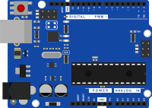
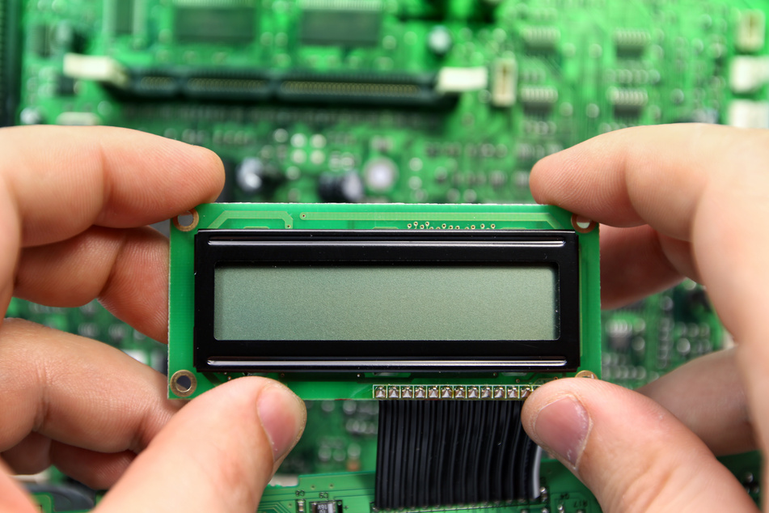
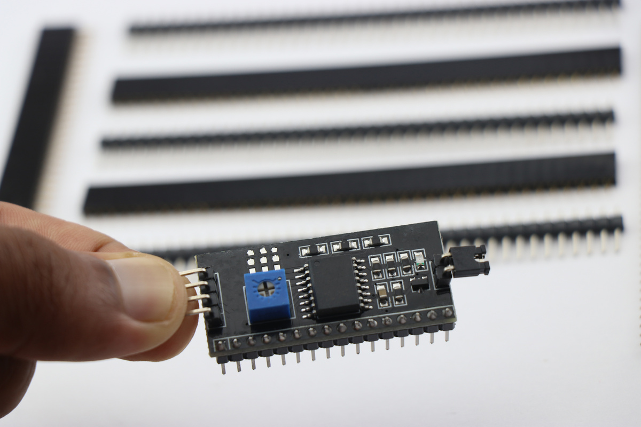
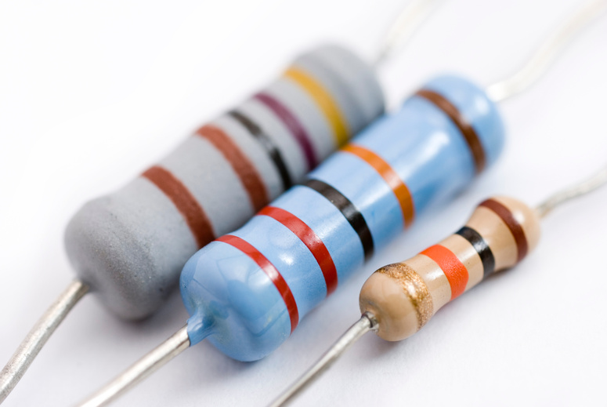
Project Description
Arduino boards are programmable circuit boards with various inputs and outputs, such as digital and analog pins, power supply, and communication interfaces.
They are designed to be user-friendly and easy to connect to sensors, actuators, and other electronic components.
Liquid crystal displays (LCDs) are flat-panel display devices that use liquid crystals to modulate light and produce images. They work by blocking or allowing light to pass through liquid crystals, which are arranged in a grid-like pattern.
The Arduino IDE (Integrated Development Environment) is a software application that allows you to write and upload code to your Arduino board.
It uses a simplified programming language based on C++, making it accessible to beginners.
While LCDs are primarily hardware components, their functionality and the images they display are controlled by software. This software, often embedded within the device itself or in a connected system, plays a crucial role in transforming raw data into the vibrant visuals we see on screens.
The I2C LCD component is used in applications that require a visual or textual display. This component is also used where a character display is needed but seven consecutive GPIOs on a single GPIO
A resistor is a passive two-terminal electronic component that implements electrical resistance as a circuit element. In simpler terms, it's a device that restricts the flow of electric current.
The I2C LCD component is used in applications that require a visual or textual display. This component is also used where a character display is needed but seven consecutive GPIOs on a single GPIO
Resistors often use a color code to indicate their resistance value and tolerance. Each color represents a specific number or multiplier.

Slide 10
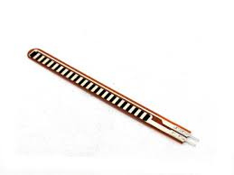
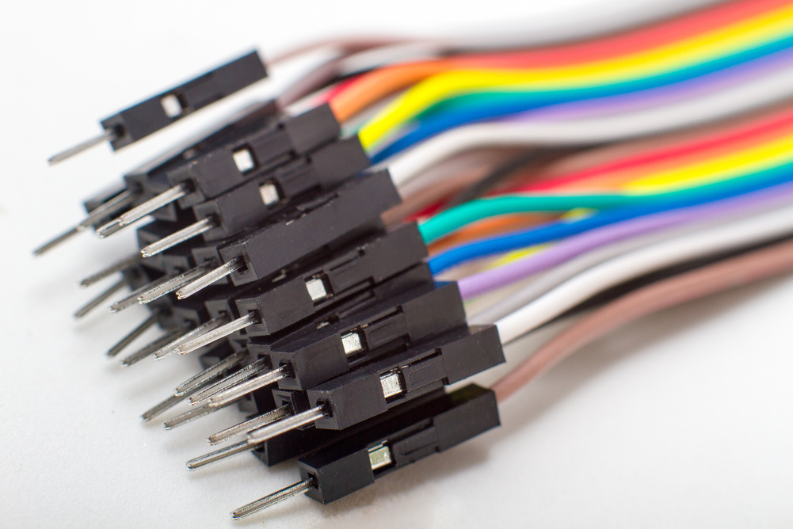
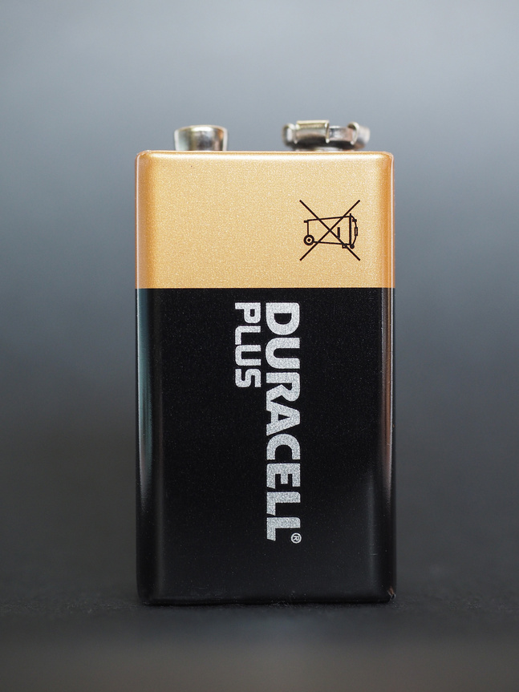
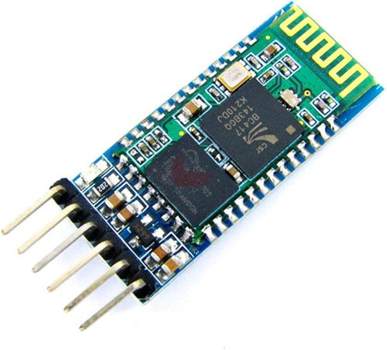
Project Description
A flex sensor, also known as a bend sensor, is a type of sensor that measures the amount of deflection or bending. It works on the principle of changing resistance with bending.
Jumper wires are electrical wires with connectors on both ends, typically used to interconnect components on a breadboard or other prototyping boards without the need for soldering. They are essential tools for hobbyists, students, and engineers to quickly and easily build and test circuits.
Flex sensors are used in wide areas of research from computer interfaces, rehabilitation, security systems and even music interfaces. It is also famous among students and hobbyists.
Male-to-Male: Both ends have male connectors (pins), allowing you to directly connect two points on a breadboard.
Male-to-Female: One end has a male connector and the other has a female connector (socket), enabling you to connect components to a breadboard or other devices with female connectors.
Female-to-Female: Both ends have female connectors, useful for extending connections or creating custom cables.
HC-06 works as a serial (RX/TX) pipe. It can be used to seamlessly pass any serial stream from 9600 to 115200bps for machine to machine (M2M) communication between your computer or mobile device to your target device using this Breakout Board. HC-06 works as Slave Module only.
While 9V batteries are versatile, it's important to note that their energy density is relatively low compared to other battery sizes. As a result, they may not be suitable for devices that require high power consumption or long battery life.
A nine-volt battery, either disposable or rechargeable, is usually used in smoke alarms, smoke detectors, walkie-talkies, transistor radios, test and instrumentation devices, medical batteries, LCD displays, and other small portable appliances.

Slide 11
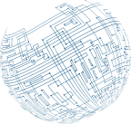
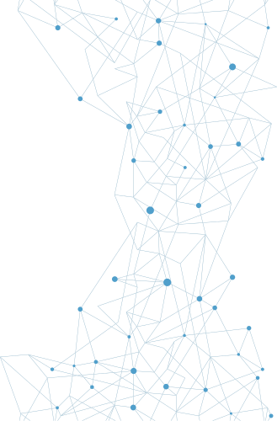
Project Explaination:
How This Works:
Small Change Detection:
The code uses abs(flex1 - prevFlex1) (and similarly for other sensors) to detect a change in sensor values.
If the change exceeds a threshold (e.g., 2), it considers this a small fluctuation.
Threshold for Change:
The threshold for detecting a small change is set to 2 (changeThreshold = 2). This means if the sensor value changes by 2 or more units from its previous reading, it will trigger the gesture detection.
Gesture Assignment:
The system will print a message indicating which finger experienced a small change (e.g., "Thumb Gesture Detected (Finger Change)").
No Fixed Finger States:
The system doesn't require fixed values for fully bent or straight fingers. Any small change will be detected and assigned as a gesture.
Prevents Multiple Detections for Same Change:
The system checks for changes only when the value fluctuates by more than the threshold value (2 in this case), preventing the detection of insignificant or very minor fluctuations.
Visual Feedback:
The system prints out the gesture detection message whenever a fluctuation above the threshold is detected

Slide 12


Mobile
Block Diagram
Hand Gesture
Bluetooth Module
Flex Sensor
Arduino
LCD

Slide 13

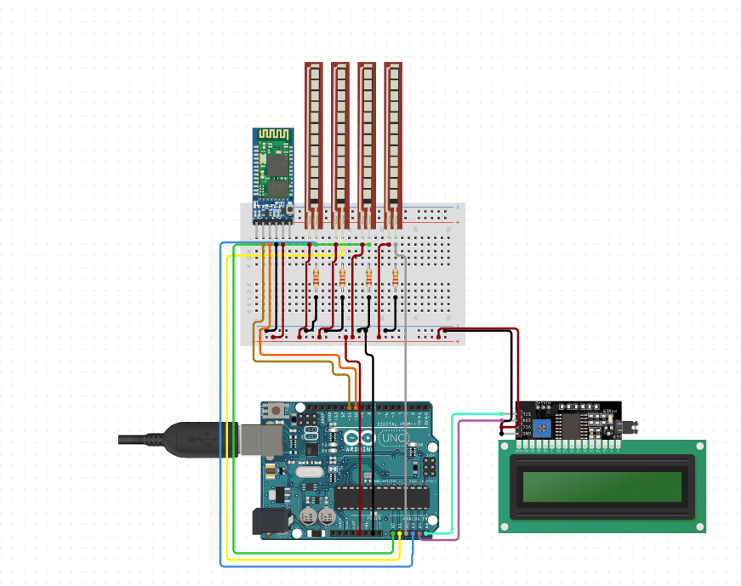
Circuit Diagram
SENSOR GLOVE

Slide 14

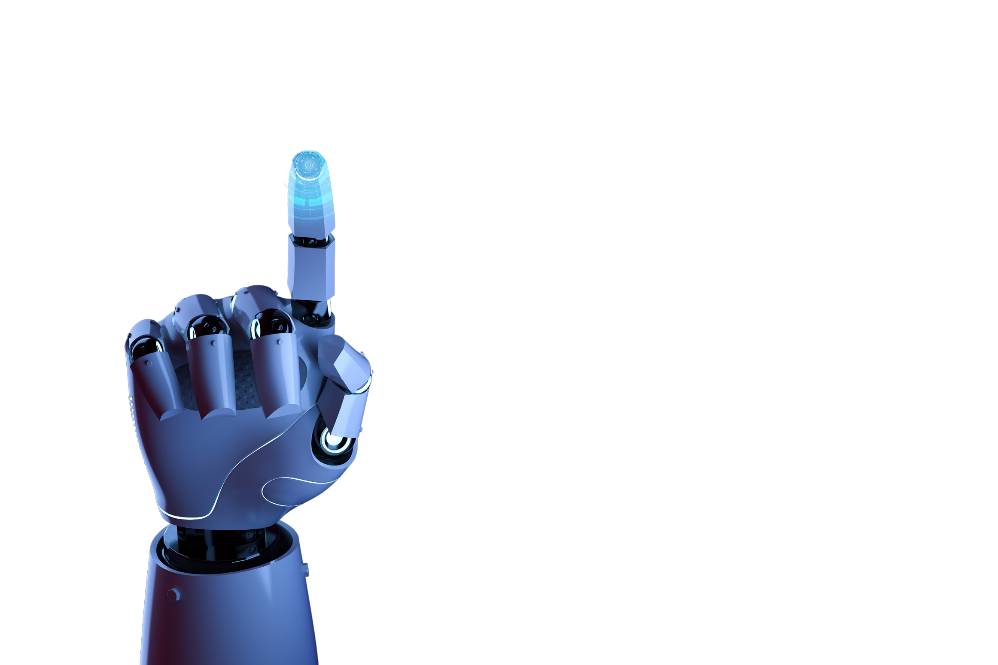
PROGRAMMING CODE:
// Pin configuration for 4 flex sensors (one for each finger)
const int flexPins[] = {A0, A1, A2, A3}; // Flex sensors connected to A0, A1, A2, A3
// Variables to store sensor values and previous values
int flex1, flex2, flex3, flex4;
int prevFlex1 = 0, prevFlex2 = 0, prevFlex3 = 0, prevFlex4 = 0;
void setup() {
// Initialize serial communication
Serial.begin(9600); // For debugging
Serial.println("Sign Glove Ready");
}
void loop() {
// Read the current flex sensor values
flex1 = analogRead(flexPins[0]);
flex2 = analogRead(flexPins[1]);
flex3 = analogRead(flexPins[2]);
flex4 = analogRead(flexPins[3]);
// Detect gestures based on small changes (e.g., +/-2 or more in sensor values)
detectGesture(flex1, flex2, flex3, flex4, prevFlex1, prevFlex2, prevFlex3, prevFlex4);

Slide 15
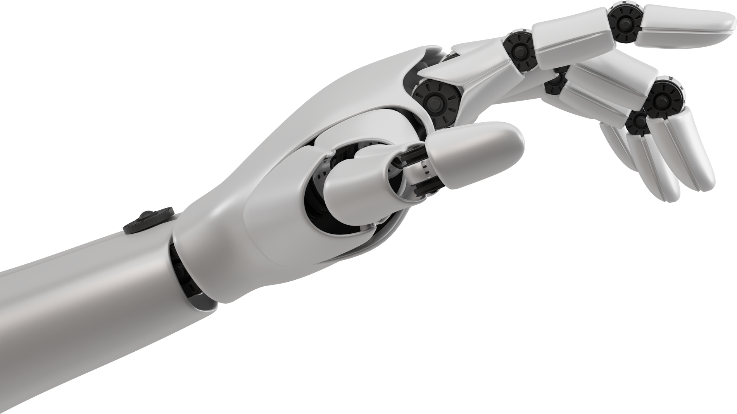
// Store the current values as the previous values for the next loop
prevFlex1 = flex1;
prevFlex2 = flex2;
prevFlex3 = flex3;
prevFlex4 = flex4;
// Add a small delay to avoid flooding
delay(200);
}
//Function to detect gestures based on small changes in the sensor values
void detectGesture(int f1, int f2, int f3, int f4, int prevF1, int prevF2, int prevF3, int prevF4) {
// Set the change threshold (e.g., any change greater than 2)
int changeThreshold = 2;
// Check if there's a small change in any flex sensor value (more than 2 units)
if (abs(f1 - prevF1) >= changeThreshold || abs(f2 - prevF2) >= changeThreshold ||
abs(f3 - prevF3) >= changeThreshold || abs(f4 - prevF4) >= changeThreshold) {
// Detect which finger has changed based on the fluctuation
if (abs(f1 - prevF1) >= changeThreshold) {
Serial.println(" I need water");
}
if (abs(f2 - prevF2) >= changeThreshold) {
Serial.println(" I need food");
}
if (abs(f3 - prevF3) >= changeThreshold) {
Serial.println(" I need help");
}
if (abs(f4 - prevF4) >= changeThreshold) {
Serial.println(" I need rest");
}
}
}

Slide 16
Draw Backs
Future Scope
Conclusion
Accuracy and Sensitivity
Real-time Processing
Battery Life
Comfort and Wearability
Cultural and Linguistic Nuances
Addressing these challenges requires ongoing research and development in areas like sensor technology, machine learning algorithms, and power-efficient hardware. As technology advances, we can expect to see significant improvements in the performance and usability of sign language gloves.
The future of sign language gloves holds immense potential to revolutionize communication for the deaf and hard-of-hearing community. As technology continues to advance, we can anticipate significant improvements in the following areas:
Enhanced Accuracy and Precision
Improved Wearability and Comfort
Real-time Translation and Communication
Integration with Other Technologies
Affordable and Accessible Technology
By addressing the current limitations and exploring these future directions, sign language gloves have the potential to empower the deaf and hard-of-hearing community, breaking down communication barriers and fostering greater inclusivity.
Sign language gloves, with their potential to bridge the communication gap between the hearing and deaf communities, represent a significant advancement in assistive technology. By leveraging the power of sensors, microcontrollers, and machine learning, these devices can accurately recognize and translate sign language gestures into spoken language or text. While current technology still faces challenges in terms of accuracy, wearability, and battery life, ongoing research and development promise to overcome these limitations. As technology continues to evolve, sign language gloves have the potential to become a powerful tool for empowering deaf individuals and fostering greater inclusivity

Slide 17

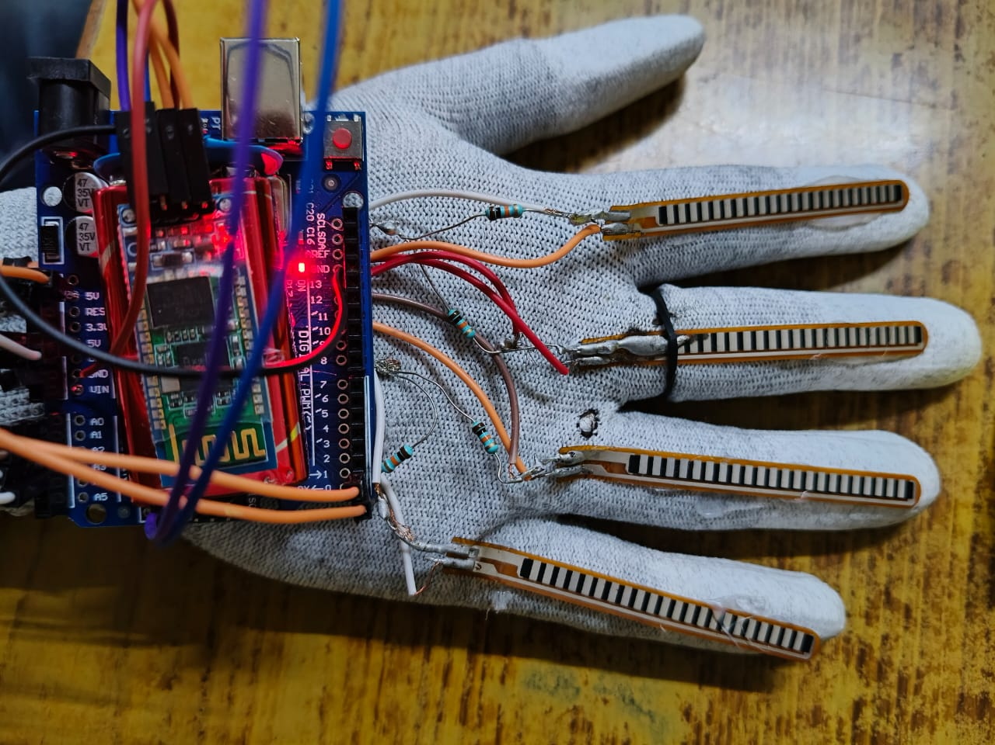
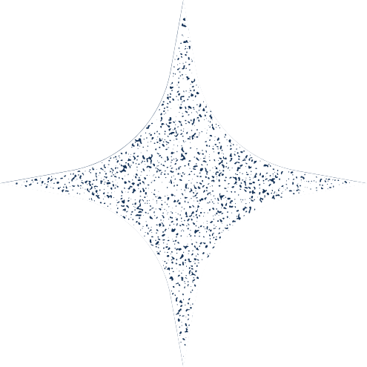
Thank you!

